Slide 1
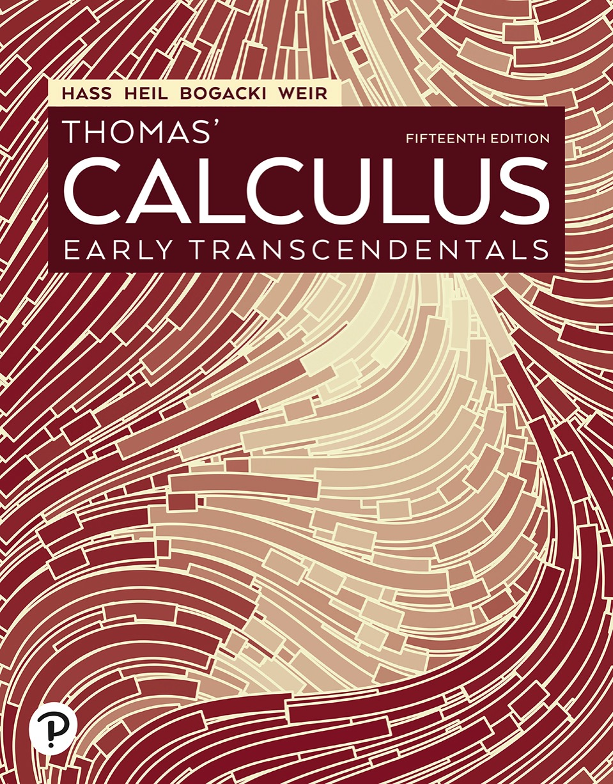

Thomas’ Calculus: Early Transcendentals
Fifteenth Edition
Chapter 13
Vector-Valued Functions and Motion in Space
Copyright © 2023, 2018, 2014 Pearson Education, Inc. All Rights Reserved
Notes:
If this PowerPoint presentation contains mathematical equations, you may need to check that your computer has the following installed:
1) MathType Plugin
2) Math Player (free versions available)
3) NVDA Reader (free versions available)

Slide 2
Section 13.6 Velocity and Acceleration in Polar Coordinates

Slide 3
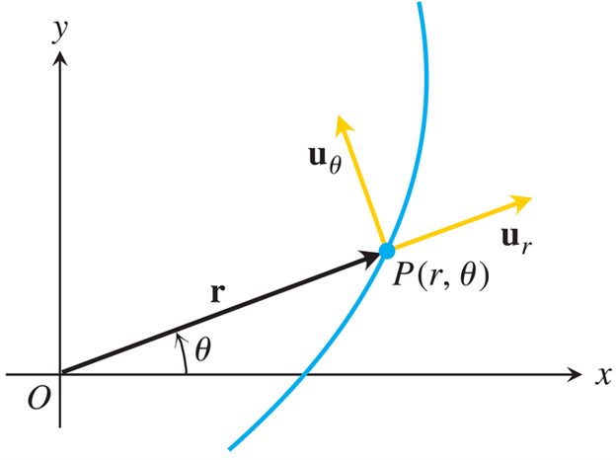
Motion in Polar and Cylindrical Coordinates (1 of 3)
The length of r is the positive polar coordinate r of
the point P. Thus,
which is
is also
Notes:
A vector, r, from the origin meets the curve at point P (r, theta). Vector r makes an angle of theta with the x axis. Two vectors, u sub theta and u sub r, emerge from point P (r, theta). U sub r moves outward, while u sub theta moves inward.

Slide 4
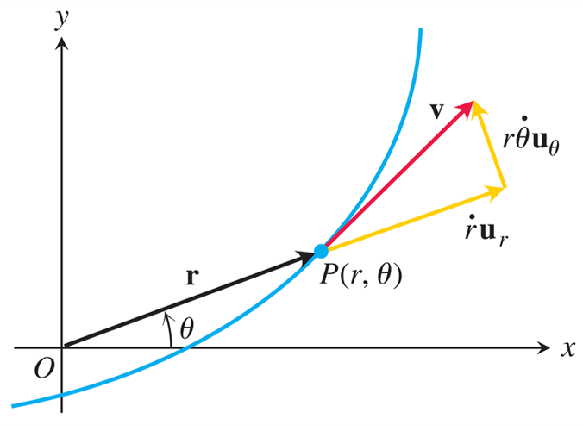
Motion in Polar and Cylindrical Coordinates (2 of 3)
In polar coordinates, the velocity vector is
Notes:
A vector, r, rises from the origin and meets the curve at point P (r, theta). Vector r makes an angle of theta with the x axis. Two vectors, v and derivative of r with respect to t times u sub r, emerge outward, from point P (r, theta). Another vector joins these 2 vectors and is labeled, r times derivative of theta with respect to t times u sub theta.

Slide 5
Motion in Polar and Cylindrical Coordinates (3 of 3)
Position:
Velocity:
Acceleration:

Slide 6
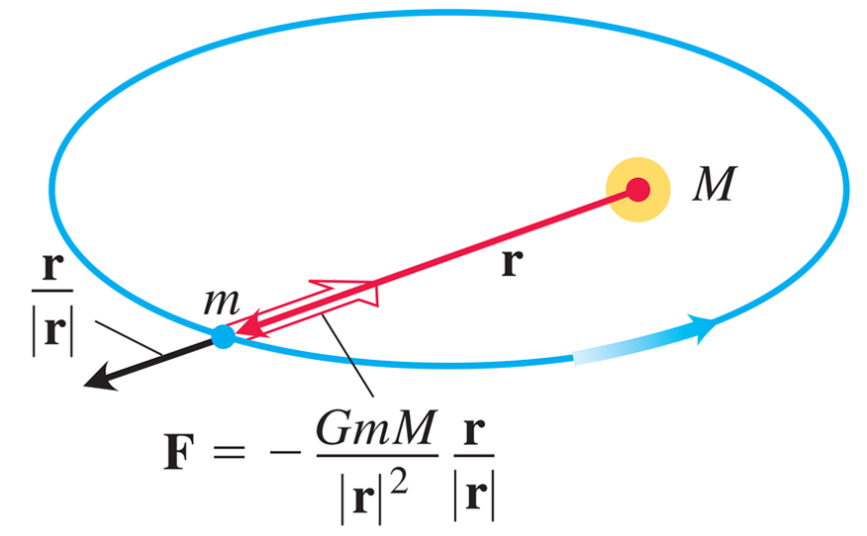
Planets Move in Planes (1 of 2)
The force of gravity is directed along the line joining the centers of mass.
Notes:
The planet of mass lower m orbits the sun of mass upper m. A vector r from the sun extends to the planet. A vector, start fraction r over the absolute value of r end fraction, runs outward from lower m. A vector runs inward from lower m and is labeled, F = negative start fraction G lower m upper m over the absolute value of r squared end fraction times start fraction r over the absolute value of r end fraction.

Slide 7
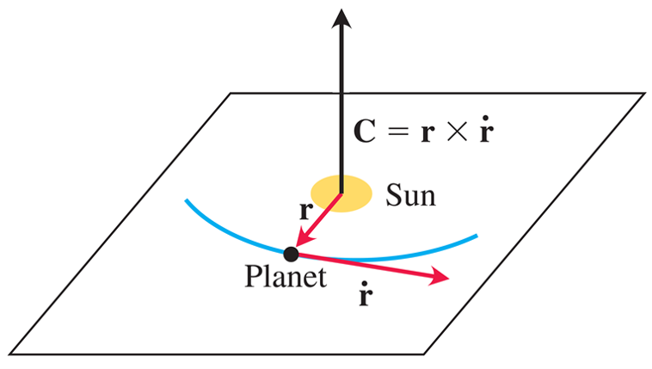
Planets Move in Planes (2 of 2)
A planet that obeys Newton’s laws of gravitation and motion travels in the plane through the sun’s center
of mass perpendicular to
Notes:
The sun and the planet are on a horizontal plane. The planet orbits around the sun in a curved manner. A vector from the center of the sun is perpendicular to the plane. This vector is labeled, C = r times first derivative of r with respect to t. A vector r runs from the sun to the planet. From the planet, a vector labeled, first derivative of r with respect to t, runs tangential to the planet’s orbit.

Slide 8
Kepler’s First Law (Ellipse Law)
Kepler’s first law says that a planet’s path is an ellipse with the sun at one focus. The eccentricity of the ellipse is
and the polar equation is
Here
is the speed when the planet is positioned at
its minimum distance
from the sun. The sun’s
mass M is

Slide 9
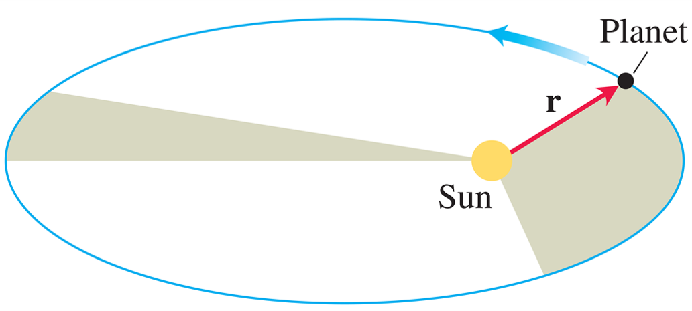
Kepler’s Second Law (Equal Area Law) (1 of 2)
The line joining a planet to its sun sweeps over equal areas in equal times.

Slide 10
Kepler’s Second Law (Equal Area Law) (2 of 2)
Kepler’s second law says that the radius vector from the sun to a planet (the vector r in our model) sweeps out equal areas in equal times.

Slide 11
Kepler’s Third Law (Time–Distance Law)
The time T it takes a planet to go around its sun once is the planet’s orbital period. Kepler’s third law says that T and the orbit’s semimajor axis a are related by the equation

Slide 12

Copyright
This work is protected by United States copyright laws and is provided solely for the use of instructors in teaching their courses and assessing student learning. Dissemination or sale of any part of this work (including on the World Wide Web) will destroy the integrity of the work and is not permitted. The work and materials from it should never be made available to students except by instructors using the accompanying text in their classes. All recipients of this work are expected to abide by these restrictions and to honor the intended pedagogical purposes and the needs of other instructors who rely on these materials.

